Slide 1

Using the library homepage to search for information
PG Poutama STEPPS Tools 2016

Slide 2
Take a 30 second tour of the university Libraries and Learning Services homepage to help you as you search for information.
View this tour by opening this power point in “Full Screen View” or “Reading View” mode.

Slide 3
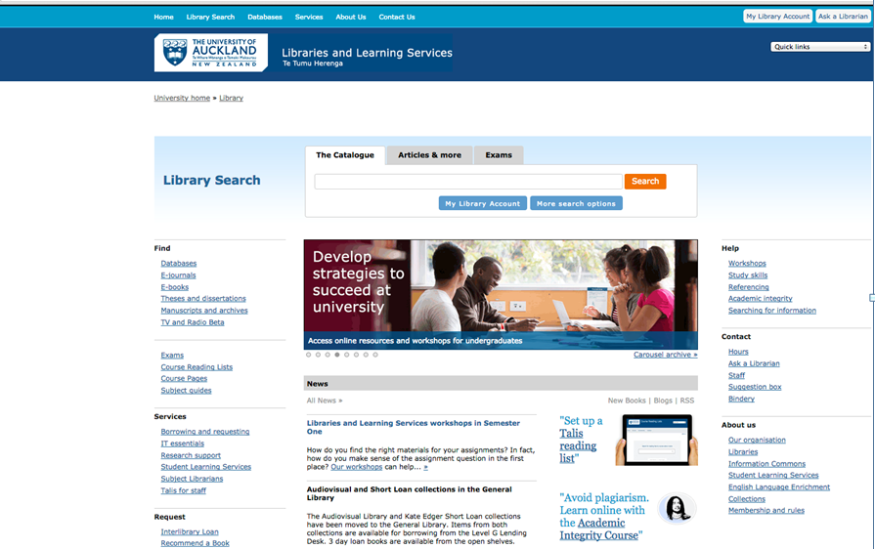
Visit the Libraries and Learning Services homepage at: http://www.library.auckland.ac.nz/

Slide 4
1.
You can make entries by adding key words in the box shown below to search for books, articles and more from the library online and printed catalogue.
1.

Slide 5
2.
Search for databases and e-journals relevant to your study.
2.

Slide 6
3.
Access support to develop your study skills.
3.

Slide 7
Contact the Library for support with searching for information in courses and for assignments:
http://www.library.auckland.ac.nz/
Ask a Librarian:
http://www.library.auckland.ac.nz/ask-a-librarian/
Searching for information support:
http://www.library.auckland.ac.nz/study-skills/searching
Workshops to learn about searching for information:
https://www.library.auckland.ac.nz/workshops/

Slide 8
All the best with your study.
PG Poutama STEPPS Tools 2016
https://www.flexiblelearning.auckland.ac.nz/stepps/

