Slide 1
Searching for information using the ‘Articles and more” library tab
PG Poutama STEPPS Tools 2016

Slide 2
Take a 30 second tour of the university Libraries and Learning Services homepage searching tab called “Articles and more”. View this tour by opening this power point in “Full Screen View” or “Reading View” mode.

Slide 3
Visit the Libraries and Learning Services homepage at: http://www.library.auckland.ac.nz/

Slide 4
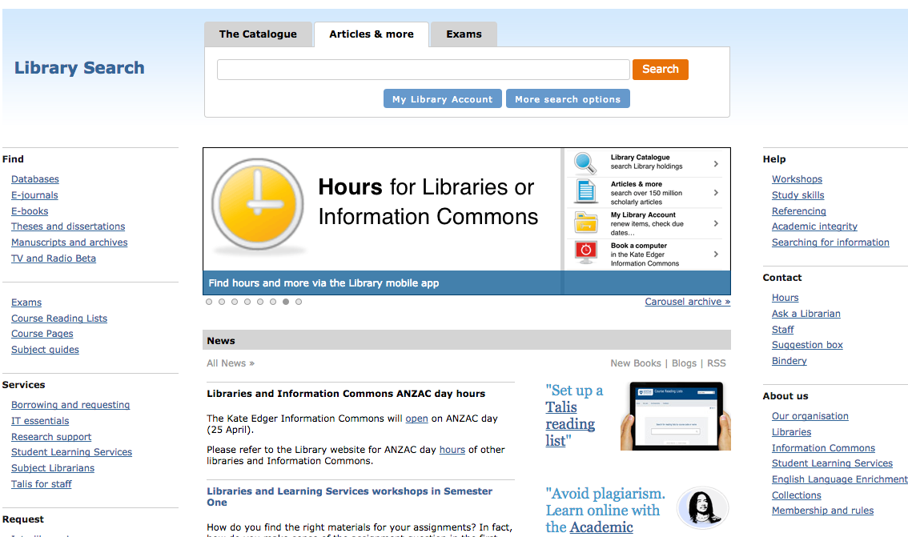
1.
You can search for articles for assignments using the Articles and more tab in the Library Search area of the L&LS hompage.
1.

Slide 5
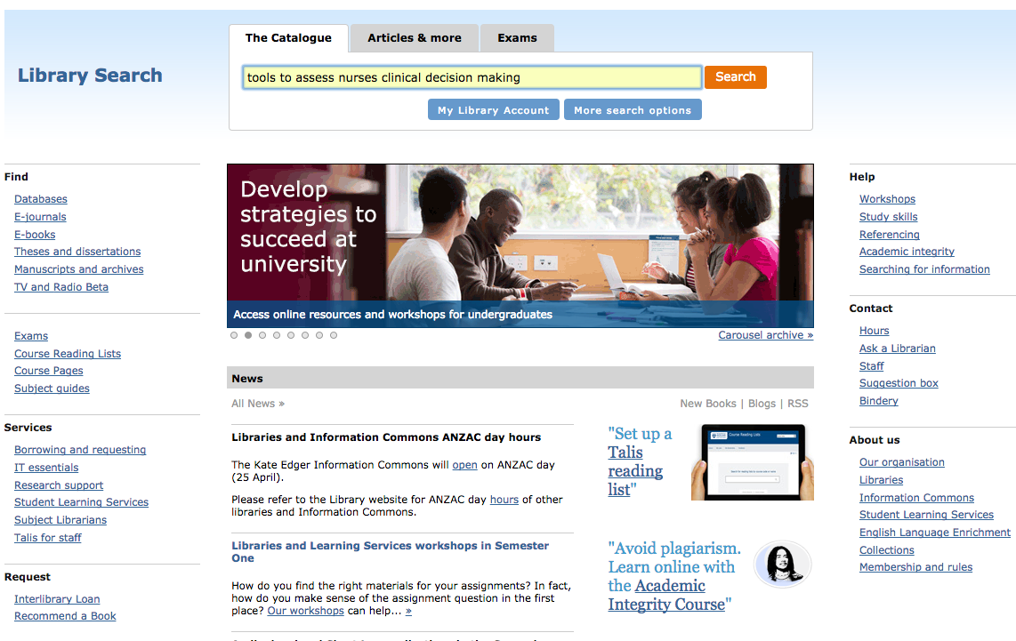
2.
Enter the name of an article or a set of search words into the Articles and more Library Search area and click the orange “Search” button.
2.

Slide 6
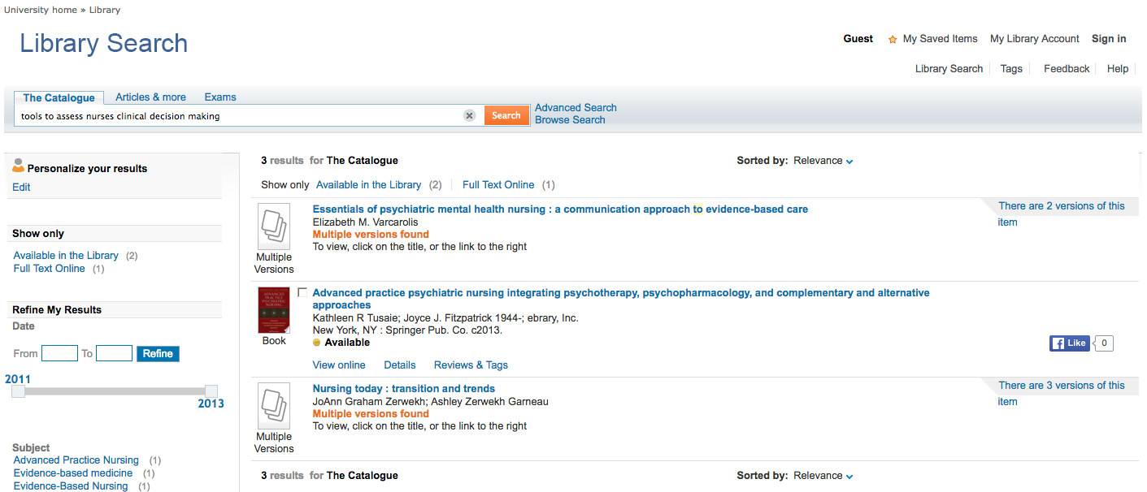
You will be shown a list of possible articles, books or related texts that match your search terms – these will be available in electronic, or print form, in the University of Auckland Library collections. Click on the name of the text / article to open more information about the item.
3.
3.

Slide 7
Contact the Library for support with searching for information in courses and for assignments:
http://www.library.auckland.ac.nz/
Ask a Librarian:
http://www.library.auckland.ac.nz/ask-a-librarian/
Searching for information support:
http://www.library.auckland.ac.nz/study-skills/searching
Workshops to learn about searching for information:
https://www.library.auckland.ac.nz/workshops/

Slide 8
All the best with your study.
PG Poutama STEPPS Tools 2016
https://www.flexiblelearning.auckland.ac.nz/stepps/

